Slide 1
Introduction to compute clustering
Lauren Wasson, Ph.D.
July 30, 2020

Slide 2
Already lost? Here’s a reference
https://github.com/drlaurenwasson
Github is a software development platform
It is open source
It is active
It is common (teaching, development, etc)
I currently have two main sections on github
R programming
Compute clustering

Slide 3
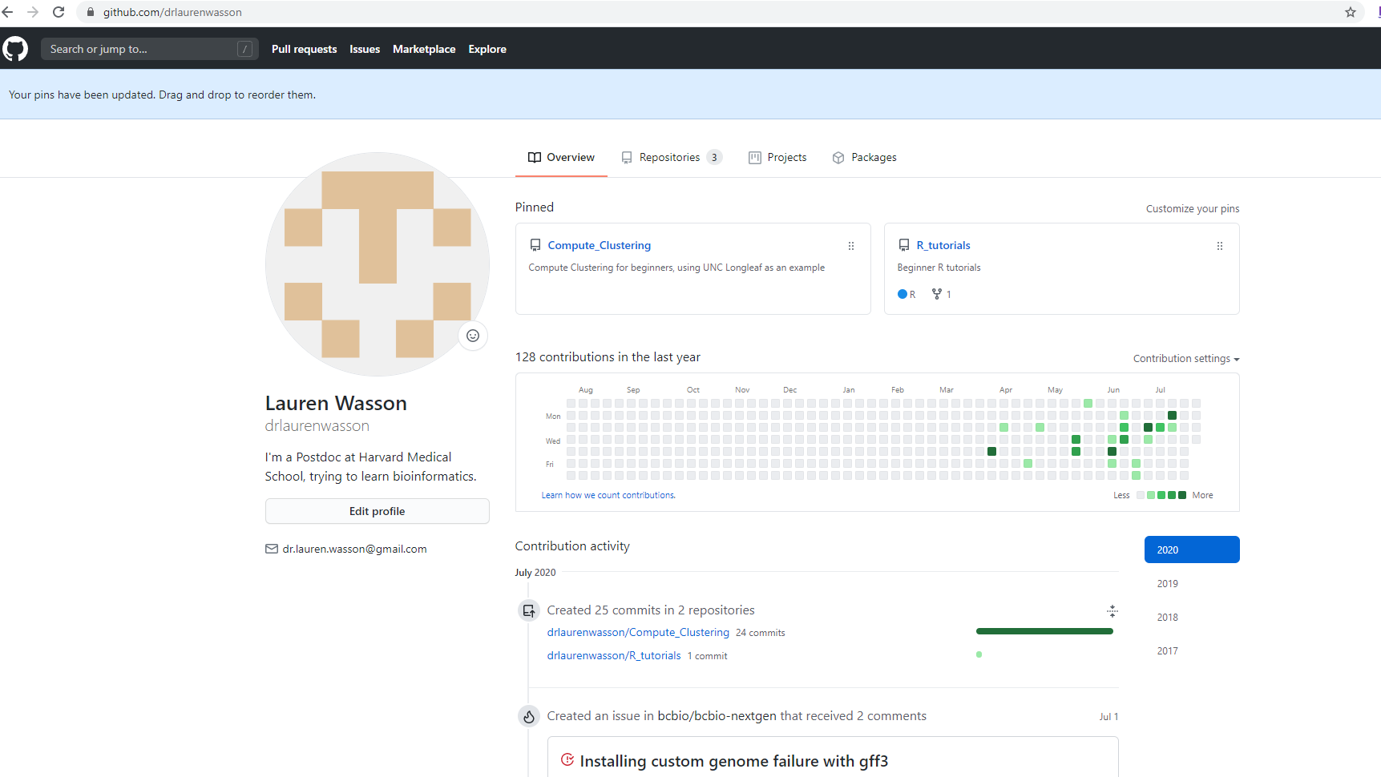
Repositories
Questions about programming that I had

Slide 4
Compute Clustering 101- Why use this?
The Longleaf cluster is a Linux-based computing system available to researchers across the campus free of charge.
Has nearly 6500 conventional compute cores delivering 13,000 threads.
Therefore, you have free access to 6,500 computers, instead of your laptop.
You can store files, write scripts, execute jobs and do data analysis on the cluster
Like a cloud…

Slide 5
UNC Longleaf- /proj space
Each onyen (when you request access) has 30 GB storage
Not really enough to do any work.
It is backed up (I will likely keep backups of scripts, etc on here)
Each onyen also has mass storage (2TB?)
This is also backed up, but it’s not designed to do work. Its for long term storage.
Conlon lab has 5TB space on the cluster
Store fastq (raw sequencing reads), bed, bam files
Download/upload data from GEO, etc
Analyze data

Slide 6
UNC Longleaf- Getting onto the cluster
1. Request access (https://its.unc.edu/research-computing/request-a-cluster-account/)
Your preferred shell is bash
Download UNC’s vpn (only if you’re home).
https://help.unc.edu/sp?id=kb_article_view&sysparm_article=KB0010155&sys_kb_id=87af20281b7f4c90b7de21b5ec4bcb99
Download a gateway (Windows users only) or open a Terminal (Mac users)
MobaXterm (Home edition)
Git Bash (this is the one I’m familiar with)
SSH Secure Shell
SecureCRT
https://its.unc.edu/research-computing/getting-logged-on/

Slide 7
UNC Web portal for Longleaf
As of March 2020, theres a web portal for Longleaf
It seems to work pretty well, but I actually find it more complicated to submit jobs etc.
https://ondemand.rc.unc.edu/pun/sys/dashboard

Slide 8
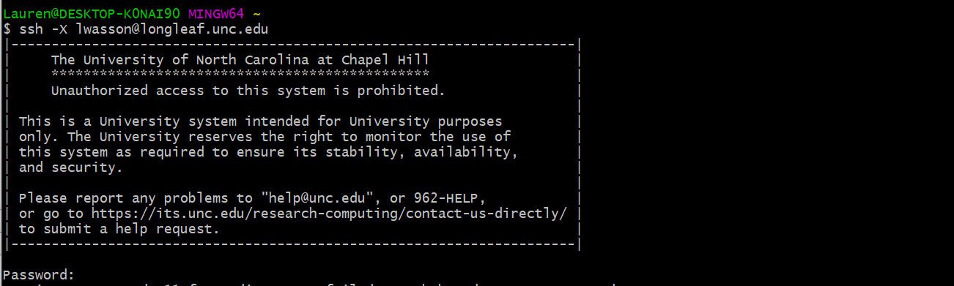
Getting onto the cluster
ssh ONYEN@longleaf.unc.edu

Slide 9
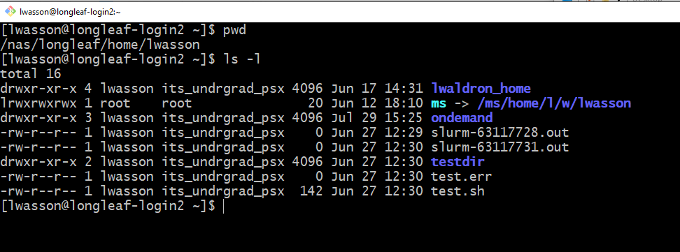
Login Node
pwd = print working directory
(Where am I on the cluster? What folder am I in?)
[Onyen@longleaf-login#]
ls -l lists all of the files in
the directory you are in
Here I am in my “home”
directory (~)
You log into the login node (obvs). You can submit jobs on the login node, but you can’t do interactive stuff on the login node
(this will make more sense later)

Slide 10
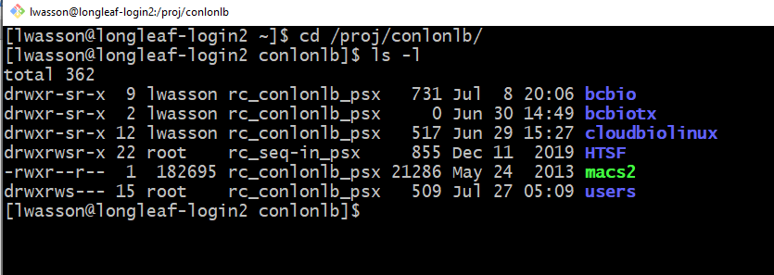
/proj/conlonlb
cd = change directory
It changed from my home (~)
to conlonlb

Slide 11
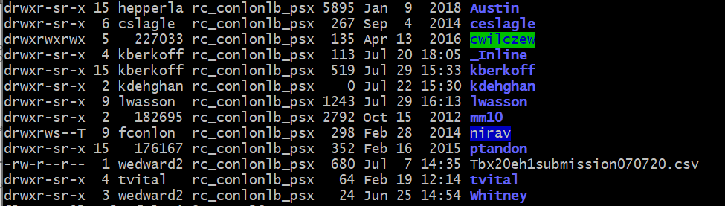
/proj/conlonlb/users

Slide 12
Basic linux commands that I use a lot
https://github.com/drlaurenwasson/Compute_Clustering/blob/master/Handy_Unix_Tips.Md
Ones that I used in previous slides
ls –l (list)
cd (change directory)
pwd (print working directory)
Google is your friend here

Slide 13
What I can teach you to do on the cluster
Load modules
Submit jobs to do
RNA-seq processing and analysis
ChIP-seq processing and analysis
Processing bed files (bedtools)

Slide 14
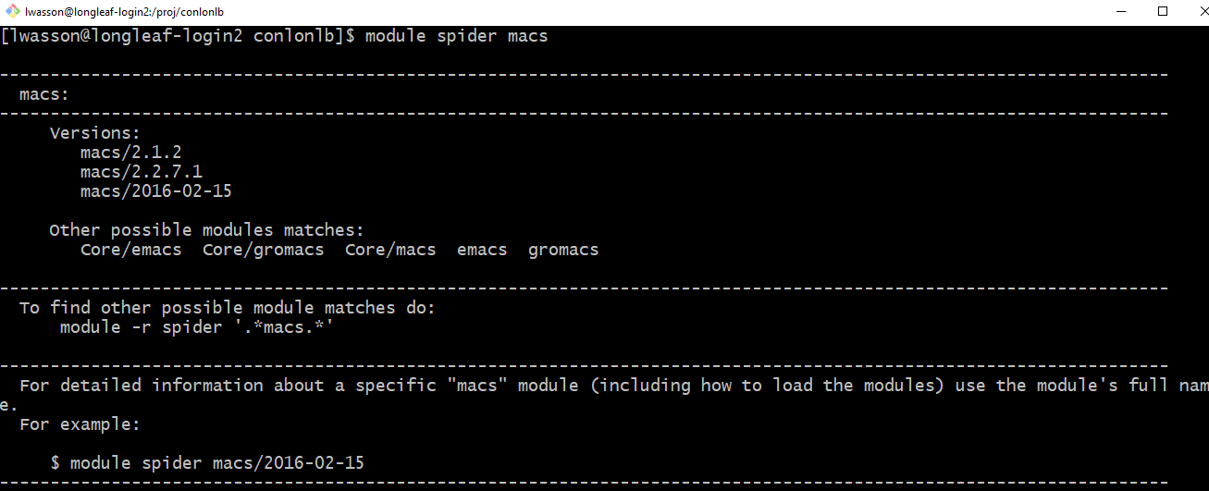
Load modules
UNC has a lot of pre-installed modules on the cluster (like packages in R, or an app on your phone)
To see what is available type “module spider <what you want>

Slide 15
Load modules
To load a module:
If you try to run a MACS2 command without loading the module first, nothing will happen, and you’ll get an error
Modules have to be loaded EVERY TIME (you can build it into your scripts). Modules get wiped every time you log off

Slide 16
What I can teach you to do on the cluster
Load modules
Submit jobs to do
RNA-seq processing and analysis
ChIP-seq processing and analysis
Processing bed files (bedtools)

Slide 17
Doing things on the cluster
The UNC cluster (and many clusters) uses the SLURM workload manager to submit jobs.
https://slurm.schedmd.com/quickstart.html
To “do things” on the cluster:
1: just type it in

Slide 18
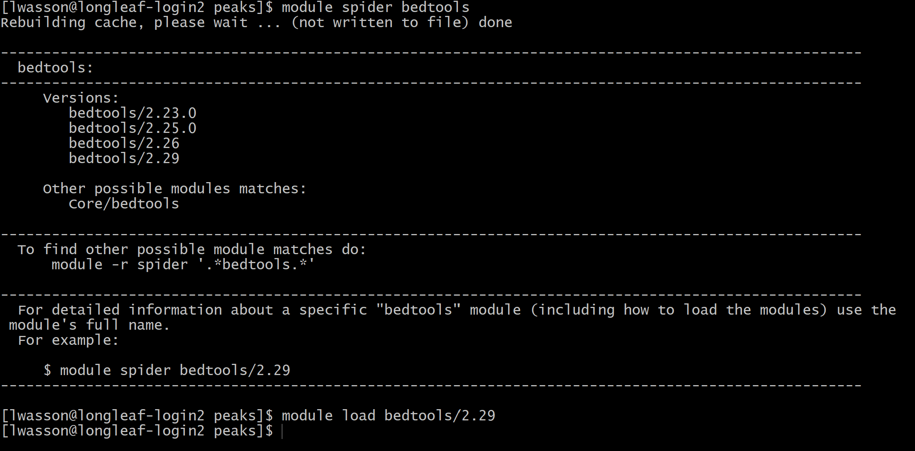
“Just type it in”

Slide 19
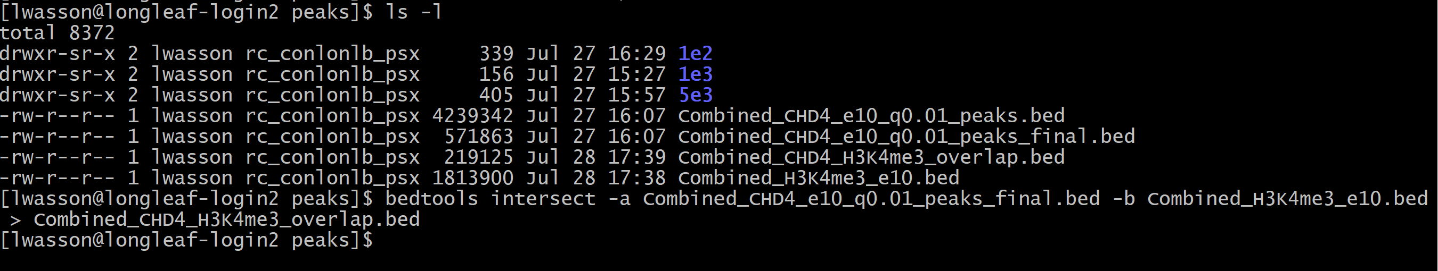
“Just type it in…”
Here I have typed a command “bedtools intersect” to intersect two bed files- CHD4 ChIP-seq data and H3K4me3 data
I have written the output (>) to a file called “Combined_CHD4_H3K4me3_overlap.bed”
Eventually, you will perform a job that you can’t do on the login node (memory etc is small on the login node and its bad
practice to do work on the login node)
You have two choices:
Get on a compute node in “interactive mode”
Write a script and submit to the cluster.

Slide 20
To get on an interactive node: submit your first job- srun
Now we are on compute node 0801
Now you can type in all the commands you want!
- But you’ll have to reload your modules.
The main difference is that srun is interactive and blocking (you get the result in your terminal and you cannot write other commands until it is finished), while sbatch is batch processing and non-blocking (results are written to a file and you can submit other commands right away)

Slide 21
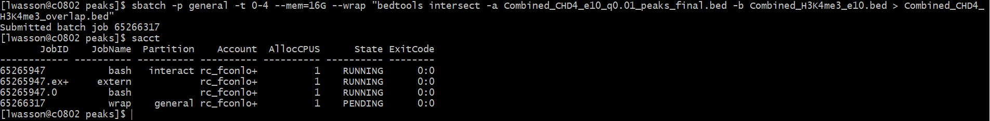
Sbatch --wrap
sbatch -p general -t 0-4 --mem=16G --wrap "bedtools intersect -a Combined_CHD4_e10_q0.01_peaks_final.bed -b Combined_H3K4me3_e10.bed > Combined_CHD4_H3K4me3_overlap.bed"
-p = partition (this will always be “general” on the unc cluster
-t = time (the amount of time you are asking for resources)
--mem = memory (the amount of memory you are asking for)
To check the status of your jobs (for the last 24 hours)
> sacct

Slide 22
Sbatch -- wrap
It’s basically a way to get around writing a script. If you’re doing an analysis for the first time, I recommend using this method of submission, because you can check your work at every step.
It’s “just type it in”, just elevated one step, as you don’t have to wait for the previous step to finish before starting a new one (this is helpful if you want to run the same command on multiple samples, for example) .

Slide 23
Writing a script and submitting with sbatch
There are lots of scripts!
.pl = Perl scripts
.py = python scripts
.sh = shell scripts

Slide 24
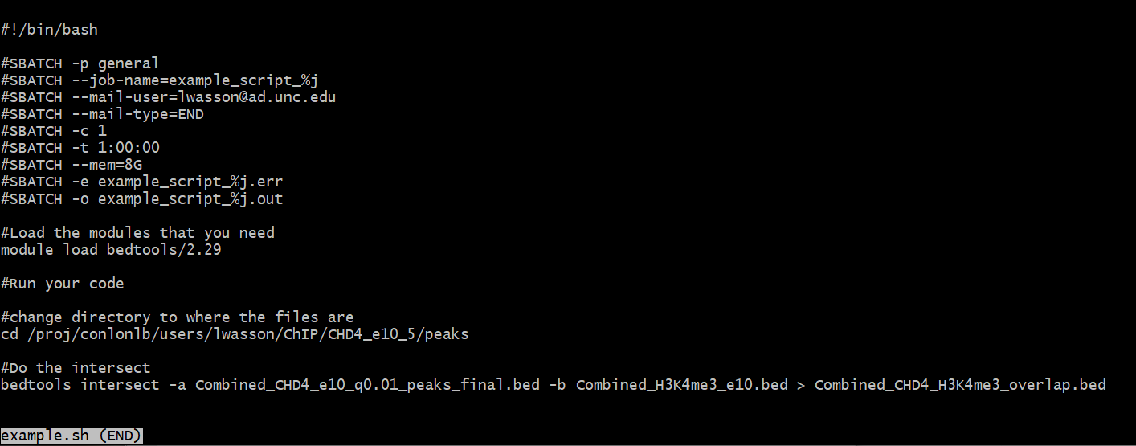
Example of a shell script

Slide 25
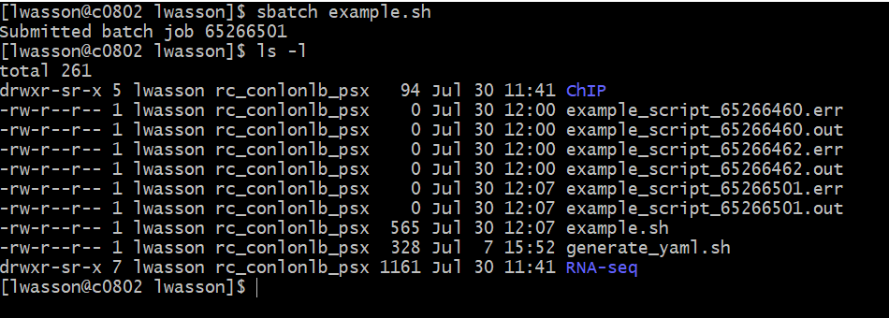
Submitting a batch script (sh)

Slide 26
UNC Research Computing Resources
https://its.unc.edu/research-computing/research-computing-presentations/#longleaf

Slide 27
My office hours

Slide 28
Call peaks using MACS2
Carries MACS2 command:
macs2 -t NS50244_160302_NS500489_AHHHG5BGXX.TS-UNC-1.1.bam -c NS50244_160302_NS500489_AHHHG5BGXX.TS-UNC-4.1.bam -f BAM -g mm -B -q 0.01 --nomodel --shiftsize 100 -n ./NS50244_160302_NS500489_AHHHG5BGXX.TS-UNC-1.1_macsdone3
Austin’s MACS2 command
macs2 callpeak –t ../bowtie_out/CHD4_Rep1_clean_sync_filt.bam -c ../bowtie_out/input_Rep1_clean_sync_filt.bam -f BAMPE -g mm -n CHD4_Rep1_clean_sync_filt
My command:
macs2 callpeak -t NS50244_160302_NS500489_AHHHG5BGXX.TS-UNC-1.1.sorted.bam -c NS50244_160302_NS500489_AHHHG5BGXX.TS-UNC-4.1.sorted.bam -f BAM -g mm -n CHD4_e10_1_q0.01 -B -q 0.01

Slide 29
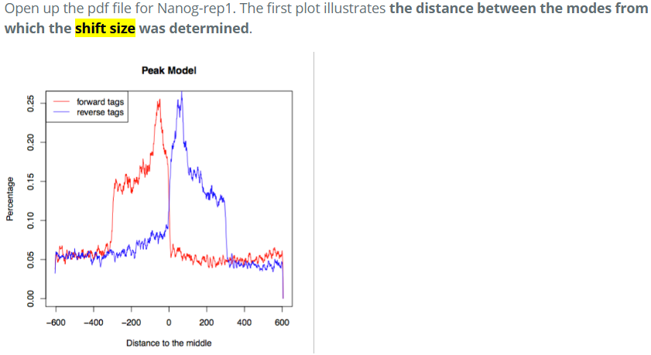
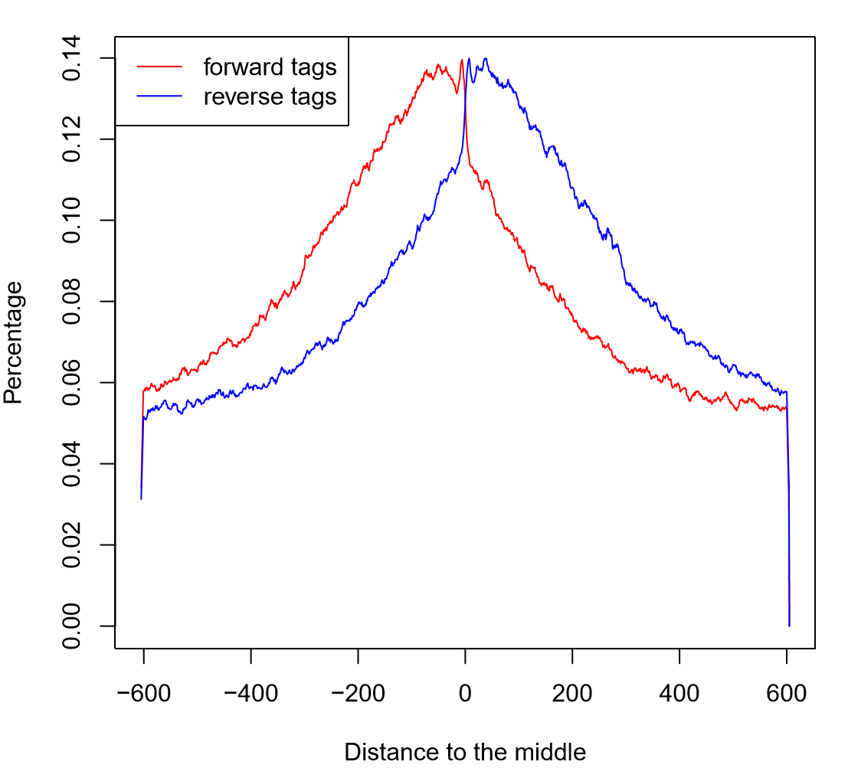
Shift size and model explanation
Modeling the shift size
The tag density around a true binding site should show a bimodal enrichment pattern (or paired peaks). MACS takes advantage of this bimodal pattern to empirically model the shifting size to better locate the precise binding sites.
To find paired peaks to build the model, MACS first scans the whole dataset searching for highly significant enriched regions. This is done only using the ChIP sample! Given a sonication size (bandwidth) and a high-confidence fold-enrichment (mfold), MACS slides two bandwidth windows across the genome to find regions with tags more than mfold enriched relative to a random tag genome distribution.
CHD4 sample 1
q = 0.01

Slide 30
Peak calls
At q=0.01- Lauren
1= 34758
2= 26324
3= 18518
High confidence: 23811 (present in 2 of 3)
At q = 0.01- Carrie
1 = 67353
2 = 48800
3 = 40349
With no q- Austin
1 = 84271
2 = 60749
3 = 50232
High confidence: 43818 (present in 2 of 3)

